Slide 1







Calculating any term
Task A: Generating sequences using n^{th} terms
1) Use substitution to find the first five terms of these arithmetic sequences.
a)
Term number (n) | 1 | 2 | 3 | 4 | 5
Term | 8 | 13 | 18 | 23 | 28
b)
Term number (n) | 1 | 2 | 3 | 4 | 5
Term | 0.35 | 0.4 | 0.45 | 0.5 | 0.55
c)
Term number (n) | 1 | 2 | 3 | 4 | 5
Term | 2.3 | 1.6 | 0.9 | 0.2 | -0.5
d)
Term number (n) | 1 | 2 | 3 | 4 | 5
Term | -3.7 | -4.4 | -5.1 | -5.8 | -6.5
2) Jun says:
The sequence must go up in three’s because it says, “+3”
Use substitution to find the first five terms and show Jun that he is mistaken.
Term number (n) | 1 | 2 | 3 | 4 | 5
Term | 4 | 5 | 6 | 7 | 8
n = 1
(1) + 3 = 4
n = 2
(2) + 3 = 5
n = 3
(3) + 3 = 6
n = 4
(4) + 3 = 7
n = 5
(5) + 3 = 8
The sequence begins at 4 and goes up 1 each time.

Slide 2







Calculating any term
Task B: Using n^{th} terms to find any term
1) The first five terms of the arithmetic sequence are 37, 32, 27, 22, and 17.
Jacob wants to find the 20th term.
37, 32, 27, 22, 17, 12, 7, 2, −2, −7, −12, −17, −22, −27, −32, −37, −42, −47, −52, −57. There it is. The 20th term is -57
His error was 2 − 5 = -3
You might have said,
“Your method was inefficient. If you know the n^{th} term use substitution.
Spot Jacob’s error and explain a better method to him.
42 − 5(20) = 42 − 100 = −58
2) Find the 20th, 100th and 1000th terms of the below sequences
a)
n = 20
7(20) − 6
= 140 − 6 = 134
n = 100
7(100) − 6
= 700 − 6 = 694
n = 1000
7(1000) − 6
= 7000 − 6 = 6994
b)
n = 20
6 − 7(20)
= 6 − 140 = −134
n = 100
6 − 7(100)
= 6 − 700 = −694
n = 1000
6 − 7(1000)
= 6 − 7000 = −6994
c)
n = 20
0.06 − 0.7(20)
= −13.94
n = 100
0.06 − 0.7(100)
= −69.94
n = 1000
0.06 − 0.7(1000)
= −699.94
d)
n = 20
(20)² + 3(20)
= 400 + 60 = 460
n = 100
(100)² + 3(100)
= 10 000 + 300 = 10 300
n = 1000
(1000)² + 3(1000)
= 1 003 000
e)
n = 20
3(20) + 15 − 4(20)²
= -1525
n = 100
3(100) + 15 - 4(100)²
= -39 685
n = 1000
3(1000) + 15 − 4(1000)²
= -3 996 985

Slide 3







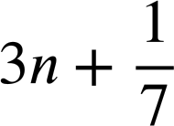
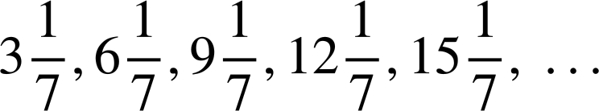





Calculating any term
Task C: Comparing n^{th} terms of different sequences
Find the first five terms of each of these sequences and compare them:
a)
b)
c)
d)
e)
f)
g)
h)
Sequences a) to g) were all arithmetic. They all had a constant common difference.
a) to e) all had a common difference of +3. They were increasing sequences.
f) and g) had a common difference of -3, decreasing.
h) is not arithmetic.
Mathematics in Education and Industry
v2.2

